Slide 1

Clustering Music from Spotify
By Christopher Clegg
ece.clegg@gmail.com

Slide 2
Why cluster music data?
The motivation:
Practice my new data science skills, see if genres can be grouped with a ML model
Interesting, important, and worth knowing
The data:
Music: Data for 170K+ songs from Spotify
Music Descripters: Acousticness, speechiness, liveness, instumentalness, energy, loudness, key, mode, etc.

Slide 3

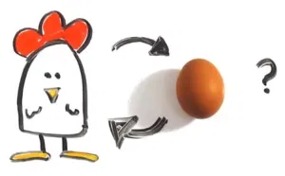
I’m open to suggestions!
Did the critics review boost sales, or did the critic’s review come after the boosted sales?
Picture Source: https://shadybeach.org/suggestion-box/

Slide 4
How important is a good recommendation? “Judging by Amazon’s success, the recommendation system works. The company reported a 29% sales increase to $12.83 billion during its second fiscal quarter, up from $9.9 billion during the same time last year. A lot of that growth arguably has to do with the way Amazon has integrated recommendations into nearly every part of the purchasing process…”
Source: https://rejoiner.com/resources/amazon-recommendations-secret-selling-online/

Slide 5
How well does this data cluster?
What data is used? What other data could be used?

Slide 6
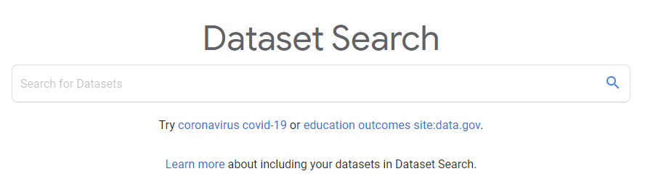
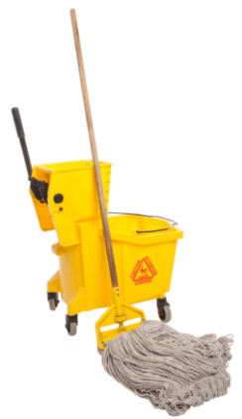

Research: A brief “play-by-play”
Search for data
Found some open-source data at Kaggle.com provided by Yamac Eren Ay using the Spotify API
Exploring and Cleaning
Data rarely comes in ideal shape and never comes conveniently pre-arranged just for you.
What to do about missing data?
Drop it or fill it in?
Preparation for the model.
Encoding, and scaling.

Slide 7

Research: A brief “play-by-play” cont’d...
Getting a feel for the data
Preliminary visualization:
Distributions
Scatterplots
What Tools Should I Use?
Determine models to use
Which model best fits the goal of this project.

Slide 8

Research: A brief “play-by-play” cont’d...
Apply clustering methods
Tuning Parameters
Visualize the results, incorporate them into an explanation that is relatable, and form a final conclusion.
Picture Source: https://www.123rf.com/photo_124220354_stock-vector-finish-banner-symbol-of-championship-successful-racing-symbol-finish-line-flat-design-eps-10-.html

Slide 9
My methods
K-Means Clustering
Gaussian Mixture Clustering
DBSCAN
These are the method I chose, and why I chose them.

Slide 10
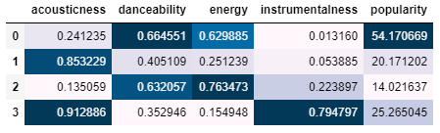
K-Means Clustering.
Cluster zero:
High danceability, energy and popularity
Low acoustic and instrumental
Possibly Rap/pop
Cluster one:
High acoustics
Low danceability and energy
Possibly Country
Cluster two:
High danceability and energy
Low popularity and acoustics
Possibly Show Tunes
Cluster three:
High acoustics and instrumentals
Low danceability and energy
Possibly Classical
Parameters:
Number of clusters: 4
Silhouette Score:
3 clusters: 0.41085
4 clusters: 0.3590
5 clusters: 0.3155
Figure 1. k-means cluster characteristics

Slide 11
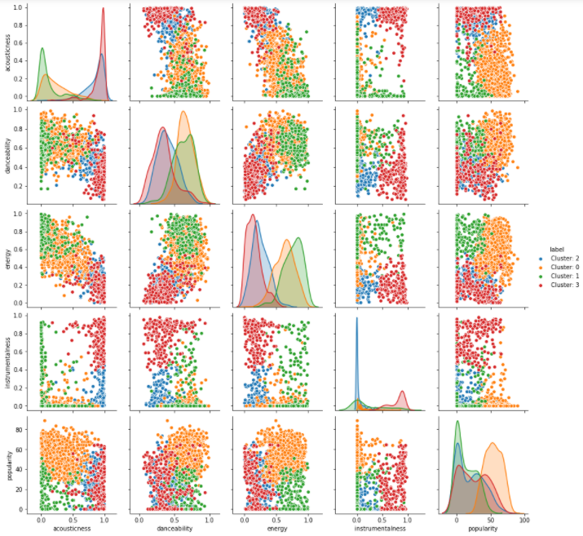
Cluster zero:
High danceability, energy and popularity
Low acoustic and instrumental
Possibly Rap/pop
Cluster one:
High acoustics
Low danceability and energy
Possibly Country
Cluster two:
High danceability and energy
Low popularity and acoustics
Possibly Show Tunes
Cluster three:
High acoustics and instrumentals
Low danceability and energy
Possibly Classical
Figure 2: Pair plot with K-Means Clustering

Slide 12
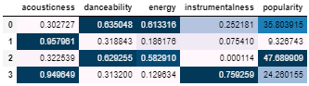
Guassian Mixture Clustering
Cluster zero:
High danceability, energy
Low acoustic and slightly lower instrumental
Possibly Show Tunes
Cluster one:
High acoustics
Low danceability and energy
Possibly Country Music
Cluster two:
High danceability, energy, and popularity
Low acoustics and instrumental
Possibly Rap/Pop
Cluster three:
High acoustics and instrumentals
Low energy and danceability
Possibly Classical
Parameters:
Number of clusters: 4
metrics: Euclidean
Silhouette Score:
3 clusters: 0.1664
4 clusters: 0.1440
5 clusters: 0.0620
Figure 3. GMM cluster characteristics

Slide 13
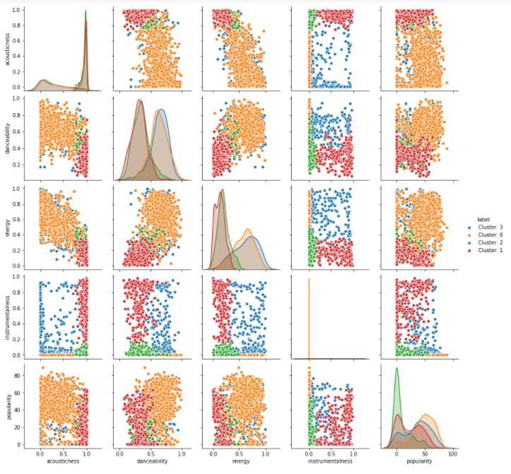
Cluster zero:
High danceability, energy and popularity
Low acoustic and instrumental
Possibly Rap/pop
Cluster one:
High acoustics
Low danceability and energy
Possibly Country
Cluster two:
High danceability and energy
Low popularity and acoustics
Possibly Show Tunes
Cluster three:
High acoustics and instrumentals
Low danceability and energy
Possibly Classical
Figure 4: pair plot with GMM clustering

Slide 14
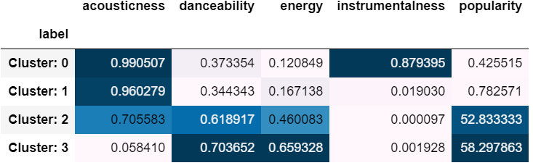
DBSCAN Clustering
Cluster zero:
High acoustics, instrumental
Low danceability and energy
Possibly Classical
Cluster one:
High acoustics
Low danceability and energy
Possibly Country Music
Cluster two:
High danceability, energy, and popularity
Low acoustics and instrumental
Possibly Rap/Pop
Cluster three:
High danceability and energy
Low acoustics
Possibly Show Tunes
Parameters:
Epsilon: 0.25
Minimum samples: 10
Metric: Euclidean
Cluster Membership:
Cluster 1: 40
Cluster 2: 14
Cluster 2: 12
Cluster 3: 10
Figure 5. DBSCAN cluster characteristics

Slide 15
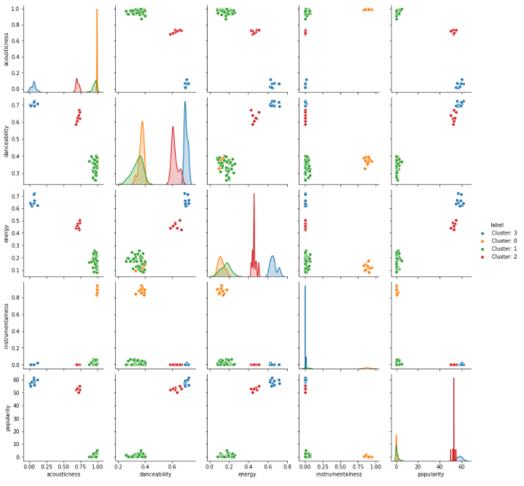
Cluster zero:
High acoustics, instrumental
Low danceability and energy
Possibly Classical
Cluster one:
High acoustics
Low danceability and energy
Possibly Country Music
Cluster two:
High danceability, energy, and popularity
Low acoustics and instrumental
Possibly Rap/Pop
Cluster three:
High danceability and energy
Low acoustics
Possibly Show Tunes
Figure 6: pair plot with DBSCAN clustering

Slide 16
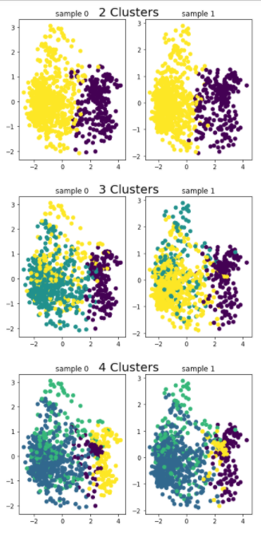
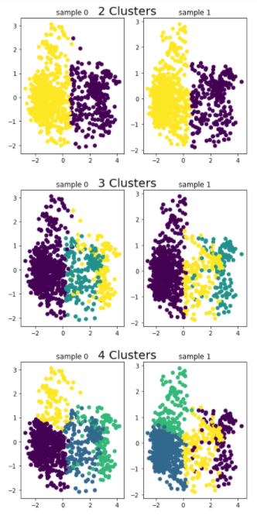
Further Investigation of The K-Means Clustering Algorithm
Consistent grouping
Not much overlap
Silhouette score for 2 cluster k-means: 0.4639
Silhouette score for 3 cluster k-means: 0.4108
Silhouette score for 4 cluster k-means: 0.3596
Reduced to 2 dimensions with PCA
Observing 2,3, and 4 clusters
K-Means vs. Gaussian Mixture
Consistent grouping for 2 clusters
Lots of overlap
Silhouette score for three cluster GMM: 0.1672
Silhouette score for four cluster GMM: 0.1439
Silhouette score for five cluster GMM: 0.0599
Further Investigation of The Gaussian Mixture Clustering Algorithm
Figure 7: Further analysis and comparison

Slide 17
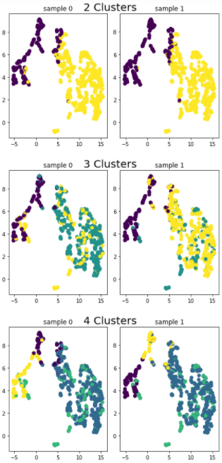
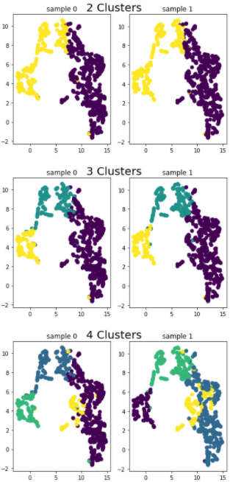
Further Investigation of The K-Means Clustering Algorithm
Consistent grouping
Not much overlap
Silhouette score for 2 cluster k-means: 0.4639
Silhouette score for 3 cluster k-means: 0.4109
Silhouette score for 4 cluster k-means: 0.3596
Reduced to 2 dimensions with UMAP
Observing 2,3, and 4 clusters
K-Means vs. Gaussian Mixture
Consistent grouping for 2 clusters
Lots of overlap
Silhouette score for three cluster GMM: 0.4614
Silhouette score for four cluster GMM: 0.1672
Silhouette score for five cluster GMM: 0.1438
Further Investigation of The Gaussian Mixture Clustering Algorithm
Figure 7: Further analysis and comparison

Slide 18
Where to go from here? Improved data sets with better genre classification Use this to generate suggestions

Slide 19
The End
Questions?

